Slide 1
YEAR 10 REVISION STRATEGIES EVENING
05/05/2026

Slide 2
Aims of this evening
To outline the most effective revision methods
To share key dates with you
To support year 10 students in beginning to plan their revision

Slide 3

The Science of Learning

Slide 4
The Learning Process
We receive new information.
This is transferred into our working memory (if we have paid enough attention)
The working memory can only hold a limited amount of information at a given time.
Through learning, information can then transfer into our long-term memory.
Our long-term memory is unlimited.
We can retrieve information back from our long-term memory into our working memory as needed.

Slide 5
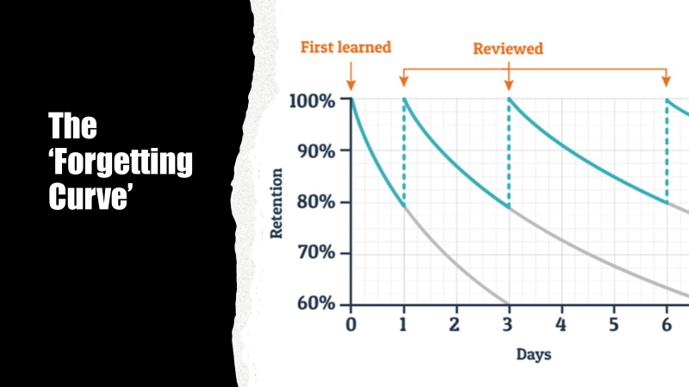
Notes:
This 'forgetting curve' is attributed to the psychologist Hermann Ebbinghaus who, in the late 1800s first suggested that humans start losing ‘memory of knowledge’ over time unless the knowledge is consciously reviewed time and again. He conducted a series of tests and found that:
· Memory retention is close to 100% at the time of learning any particular piece of information, provided sufficient attention is given to the learning. However, this drops to 60% after three days and subsequently drops even further.
· If, each day, repetition of learning occurs, then the effects of forgetting are decreased. Information should be reviewed within the first 24 hours of learning to reduce the rate of memory loss.
· The graph here gives a visual representation of how we can slow down the forgetting process through regular review of newly learned information. Which each review of the newly learned information, we slow down the forgetting process.
But what does this review of newly learned information look like? What do students have to do to review their learning?

Slide 6

Notes:
Let's look at an example. The first time any of us picked up a games controller, we probably weren't proficient at it. We firstly needed to learn how to use it. This might have been through a parent demonstrating how to use it, perhaps even teaching us how to use it. Some might have watched YouTube videos to learn, or we might have learnt through observation – observing a parent or a sibling using it. We needed to pay attention however we acquired the information of how to use a games controller, otherwise the information would not even go into our working memory. But for it then to go into our long-term memory, we needed to review our learning regularly. This might be through regular practice, regular observation of a sibling, parent or friend. But the key word here is regular. Because most people who game enjoy doing so, they don't feel that this 'reviewing of prior learning' is effortful, but in fact they are indeed putting a lot of effort in to reviewing their prior learning. And then over time, with these regular reviews of learning, many people go on to become supremely proficient in using a games controller. I imagine many of you in the room could use on with your eyes closed – literally.
So we now need to think about replicating this model with our study – it is the regularity of the review of the information initially shared with you in class that is important.
We'll now look at the most effective strategies to support you in reviewing your learning.

Slide 7
Effective Learning Strategies
Retrieval Practice
Spacing
Interleaving

Slide 8
Retrieval Practice
A learning strategy which makes you think hard.
It involves trying to recall previously learnt information rather than re-reading it.
Research has shown that actively retrieving knowledge boosts learning and strengthens memory.
Notes:
What's important here is that students are trying to remember. Rather than going to their notes and reading through key points to remind themselves what they have learnt, they start by trying to remember what they have learnt and only then do they look at their notes to compare what they were able to remember with what they had originally learnt, and to identify where they might have had gaps.
This will not feel easy, indeed it will feel hard and at the beginning may feel quite dishearterning if the learner doesn't remember much. This is why some learners give up on this strategy, because it feels hard. They then revert to what feels easier, which is re-reading notes or potentially copying out notes, but both of these methods are not believed to be effective in helping transfer information to the long-term memory which, after all, is the goal here.

Slide 9
Retrieval Practice - examples
Key word test
Memory dump
Practice exam questions
Answering verbal questions (asked by a family member/friend)
Creating materials that allow you to test yourself and then using them (e.g. flashcards)

Slide 10
Key to Success
Whichever method you use, check your answers
This allows you to identify gaps in your learning
You'll review the 'gaps' more frequently

Slide 11
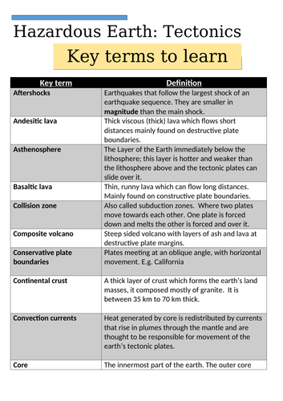
Key Word Test
Notes:
Students may be provided with key words that they need to understand the meaning of – being tested on these is a very good way of revising.
It would be useful if the person testing them could make a (mental) note of any words the learner is less certain of and re-test them on those.
Reading out the correct definition for any they were less certain of is important too.
This doesn't sound like anything revolutionary, but this will be far more effective than simply reading through this same list of key words.
There are times when there is no-one available to work alongside the learner – so they can test themselves, simply by covering up the answers and uncovering them after they have tried to recall each one.

Slide 12
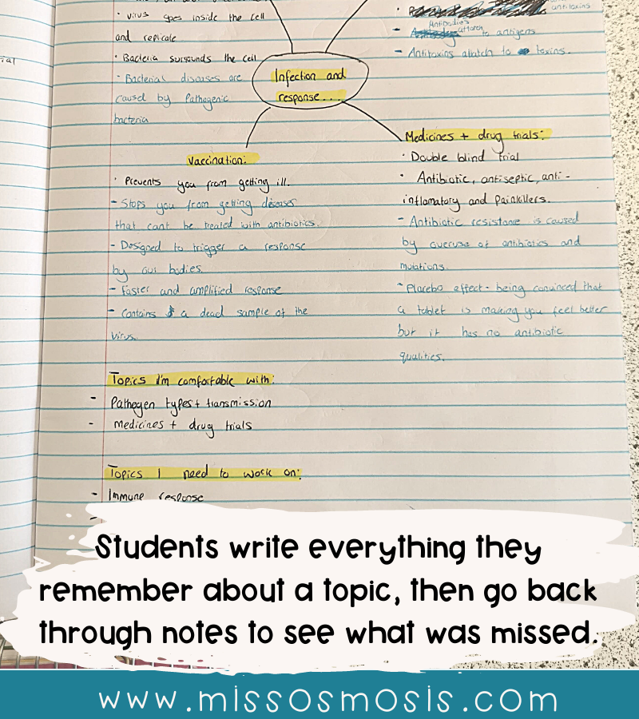
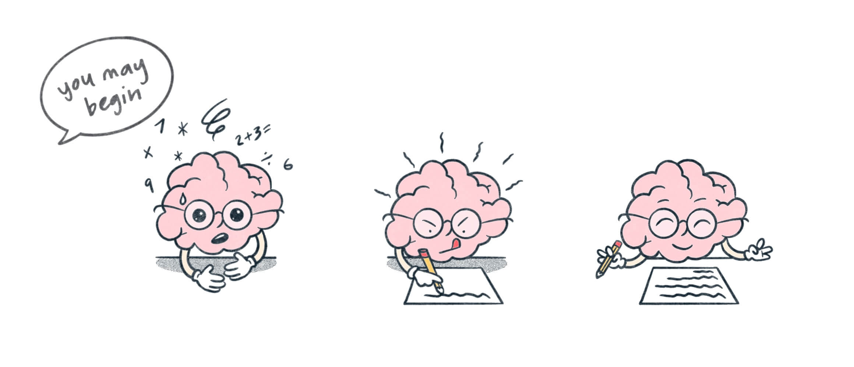
Memory dump
Notes:
This retrieval practice method involves writing everything you can remember about a particular topic on a blank piece of paper. This should be done purely from memory – remember, that’s the key to boosting your learning and strengthening your memory. It could be as simply as the example here, which is just notes on a page or you could consider setting this out in the form of a mind map (see next slide), pushing you to try to remember links between different aspects of what you have learned. I’m going to emphasise again though that you should produce your memory dump from memory. Often learners produce mind maps as a revision tool, using their notes to help them produce it. That won’t have as much benefit as trying to produce the same thing from memory. Then, once you’ve written everything you can remember it’s vital to compare what you have produced with your original notes/revision guide, to see if there is anything you didn’t note down. You could then repeat this activity a few days later and you will probably find you can remember more each time you complete this activity.

Slide 13
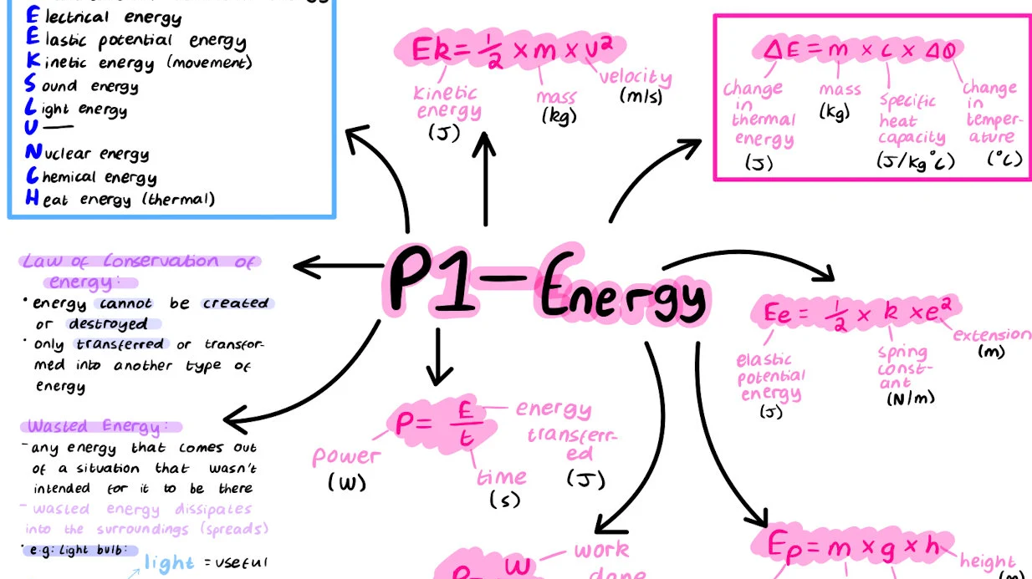
Notes:
Here is another example of what a memory dump could look like.

Slide 14
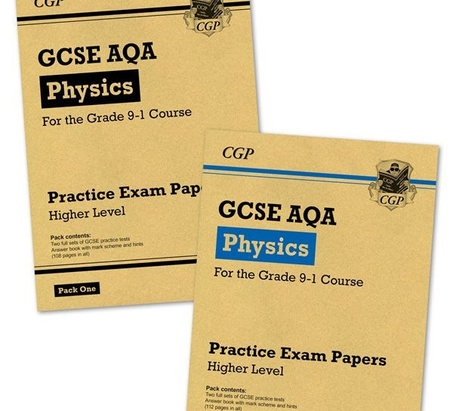

Practice Exam Questions
Notes:
Answering practice exam questions is a highly effective revision technique. Some of you might have seen resources such as these. Companies like CGP and others produce exam papers to be as close as possible to what a real GCSE might be like. The important thing is to try these questions from memory. Having notes in front of you to refer to when answering questions won’t have much impact in terms of transferring information to your long-term memory. But of course, simply doing an exam paper from memory and not actually knowing if your answers are right or wrong isn’t effective either. You need some feedback. Commercially available exam practice papers like these come with mark schemes, so you can mark your papers, or after you have completed the practice paper, you could then refer to your notes to help you understand any areas you found more challenging.

Slide 15

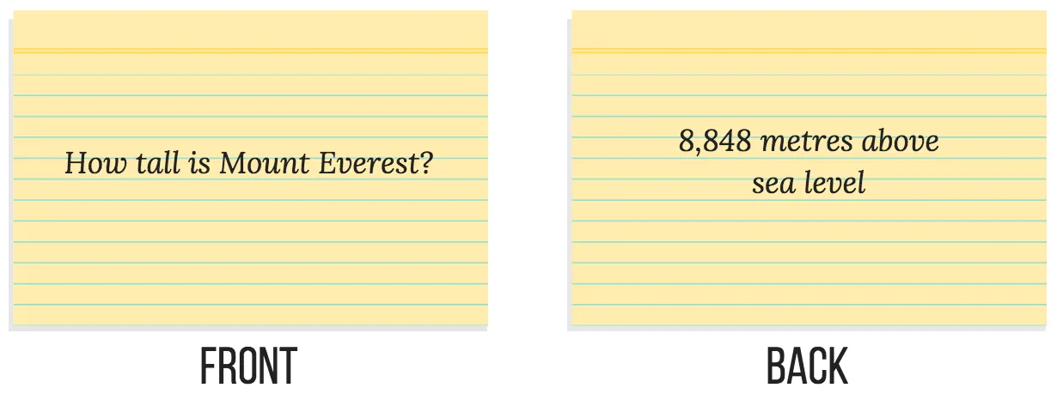
Flashcards

Slide 16
Step 1: Making them
A key term/key word on one side, its definition on the other side
A question on one side, its answer on the other side
A key date on one side, what happened on the other side
Name of an individual on one side, their achievement on the other side
A word in French/German on one side, its translation on the other side
Notes:
Using flashcards for self-quizzing is a particularly effective retrieval practice strategy. The trap some learners fall into is believing that simply creating flashcards represents good revision. Making the flashcards is only the first step. Some learners also try to use flashcards as a place to write down absolutely everything they can find out about a particular topic, as if completing a memory dump. For flashcards to be as effective as possible, try doing the following

Slide 17
Step 2: Using them
Test yourself regularly
Even better – get someone else to test you.
One pile for cards you get right, one pile for cards your get wrong.
Re-do the ‘correct’ pile occasionally.
Re-do the ‘wrong’ pile more frequently.
Follow the ‘Leitner’ system
Notes:
The Leitner system is something you can find further information about online – there are lots of useful videos on YouTube. It is a system that supports a learner to organise their flashcard revision across the full 7 days of the week.

Slide 18
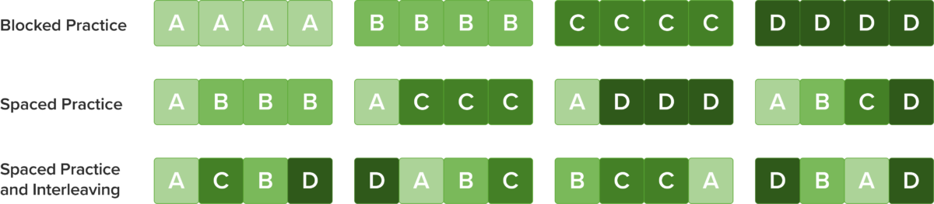
Spacing and Interleaving
Notes:
Retrieval practice is most effective when combined with spacing and interleaving. Spacing is a technique which involves spacing out your revision over time. So you would use the techniques we’ve talked about – key word quizzes, exam practice questions, flashcards etc. but you space your study out over time. This ensures you remember the material better as spacing boosts memory strength. This, in turn, will ensure you are less stressed with your revision. Interleaving involves switching between ideas and topics during a study session. Mixing up your revision and chunking it supports learning and strengthens your memory. It is also likely to help in maintaining your levels of motivation, as you won’t be studying one idea or topic for too long.
Many learners feel more secure if their revision consists of blocked practice which involves spending a significant amount of time on one topic or idea, until the learner feels secure with that topic. Unfortunately, the short-term results gained through blocked practice do not last. Spacing and interleaving are much more effective in ensuring the information is retained in the long-term memory. The diagram here shows how a learner might go about revising four separate topics. The most effective method will be the method involving spacing and interleaving and the least effective will be the method involving blocked practice.
Cramming is something many learners do immediately before an exam in a last-minute attempt to get as much information as possible into the brain. But what we know about the working memory – that it becomes overloaded quickly – means that cramming simply doesn’t work. Spacing your study out over time does. That’s why we’re encouraging you to begin your revision now.

Slide 19
Ineffective Revision Strategies
Reading notes
Copying notes
Highlighting notes
Not giving revision your full attention
Not having the right environment
‘Comfort zone’ revision
Cramming
Not planning ahead
Notes:
Simply writing out notes or copying from a textbook/exercise book/revision guide.
Reading through notes and doing nothing with the information.
Using a highlighter to highlight information and then doing nothing with the information.
Not giving enough attention to a task, e.g. revising at the same time as doing something else (looking at your phone, listening to music, watching YouTube)
Not having a suitable place to study – this can prevent you giving enough attention to a task. Try to find somewhere quiet to study. If this is difficult at home, try to attend lunchtime or after-school study sessions at school.
Engaging in ‘comfort zone’ revision – i.e. reviewing topics, ideas or concepts that you have already mastered.
Trying to ‘cram’ at the last minute rather than beginning revision with sufficient time to allow for spaced practice.
Not planning ahead. In order to ensure there is time to engage in spacing and interleaving across all subjects and all topics, planning ahead is important. A revision timetable is likely to help with this. Blank revision timetables are included at the end of this booklet to help with your revision planning.

Slide 20
Context – key dates
End of Year 10 exams: 15th to 25th June
Exam results/data report to parents: 16th July
Year 11 calendar not yet finalised
1 formal set of mocks (exam venues)
1 classroom-based set of assessments
GCSE written exams will begin around 7th May 2027

Slide 21
Next steps
Revision planning – work out how much time you have available
Factor in ‘down’ time – this is vital
Sort out the resources you might need
Then start!

Slide 22

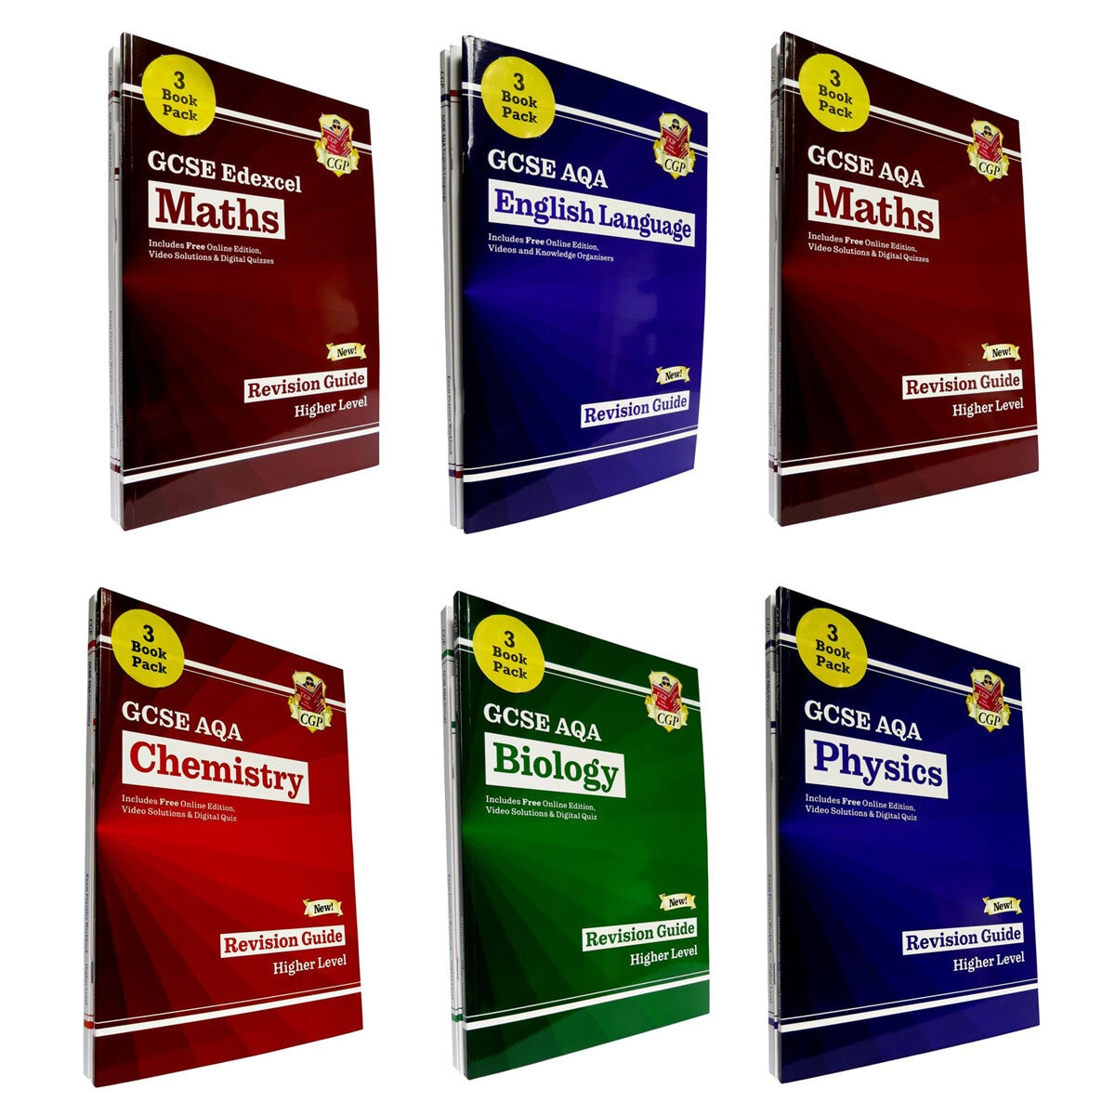


Revision Resources
Notes:
Knowing which revision guides to buy can be a total minefield! You want to support your child, you want to buy them revision guides to support their revision, but where to begin? Just on this slide, you can see revision guides published by CGP, Collins, Pearson, York Notes. They refer to different exam boards, including OCR, Edexcel, AQA. To support you with knowing what to buy, we have put some resources for you to purchase on parent pay. If you log on, you’ll find revision guides and/or workbooks for most subjects. These are the ones that our staff have identified as being appropriate to support your child’s revision. We’re able to purchase these at ‘school prices’ which is cheaper than you buying them from WHSmith or Amazon. If you missed the opportunity earlier in year 10 when we made these available, there will be further chances in year 11 to buy the relevant revision resources

Slide 23
Revision classes in school
Will be offered in year 11 – full details shared with you then
Notes:
Information about support offered in school – this is an example from last year. Some classes running this year have already begun, others will start after Christmas as students begin the final countdown. Mr Hollis will share details of these with students and parents.

Slide 24
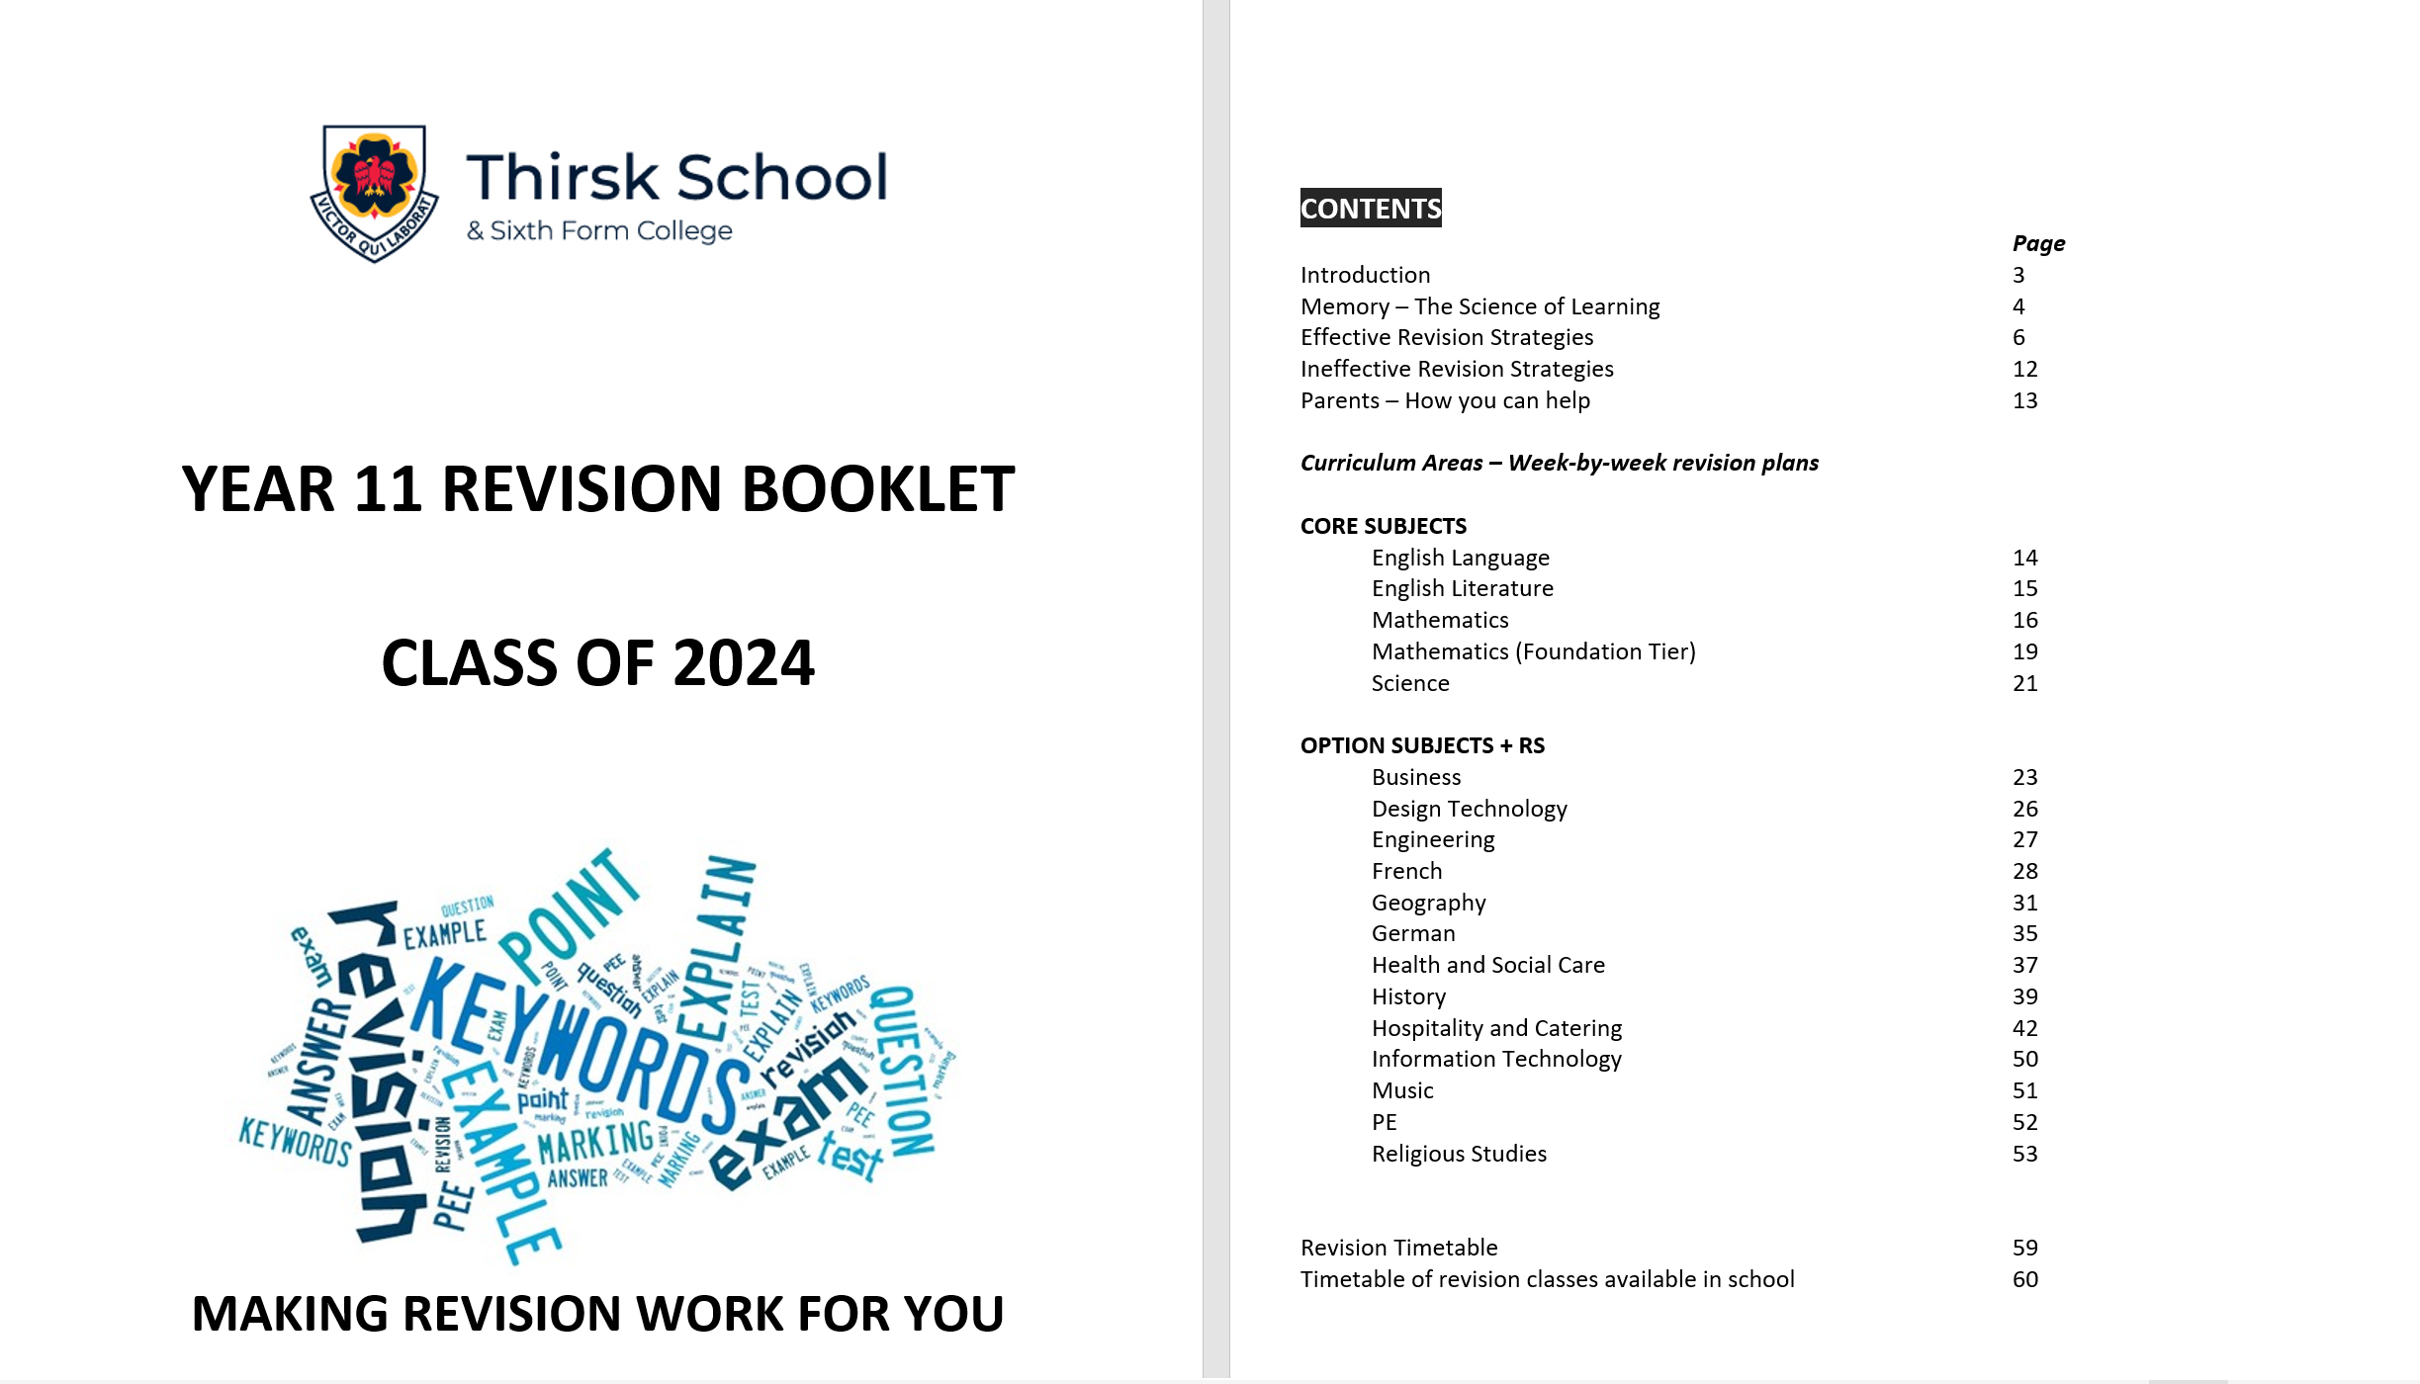
Revision homework booklet
Notes:
This is a revision resource that will be made available to all year 11s after Christmas. It contains week by week timetables of revision tasks you can do for every subject. Some students find this really helps to guide their revision, as often we hear students telling us that they want to revise, but don't know where to begin. This offers a very clear structure.

